Slide 1
Latest OKR04 Issues Tulsa HHPC Special Events
GCSA Employee Training
Nienhuis Park Community Center
May 19, 2017
Richard Smith, Stormwater Consultant

Slide 2
Who Has 2015 OKR04 Permits
1 | Altus | 14 | Edmond | 27 | Moore | 40 | Sapulpa
2 | Arkoma * | 15 | Fort Sill Army Base | 28 | Muskogee | 41 | Spencer
3 | Bartlesville | 16 | Glenpool * | 29 | Nichols Hills | 42 | Stillwater
4 | Bethany | 17 | Harrah * | 30 | Nicoma Park | 43 | Tahlequah
5 | Bixby | 18 | Jenks | 31 | Noble | 44 | Tinker Air Force Base
6 | Broken Arrow | 19 | Jones * | 32 | Norman | 45 | The Village
7 | Catoosa | 20 | Logan County * | 33 | Oklahoma County | 46 | Tulsa County
8 | Choctaw | 21 | Kiefer * | 34 | Okla. Turnpike Auth. | 47 | University of Oklahoma
9 | Claremore | 22 | Lawton | 35 | Okmulgee | 48 | Wagoner County
10 | Comanche County | 23 | McAlester | 36 | Owasso | 49 | Warr Acres
11 | Coweta | 24 | Miami | 37 | Ponca City | 50 | Yukon
12 | Creek County | 25 | Midwest City | 38 | Rogers County *
13 | Del City | 26 | Mustang | 39 | Sand Springs | * | New permittees
50 Total: 39 cities and towns; 7 counties, 4 non-municipals (7 new).
ODOT is a Phase II permittee, but has an individual permit.

Slide 3
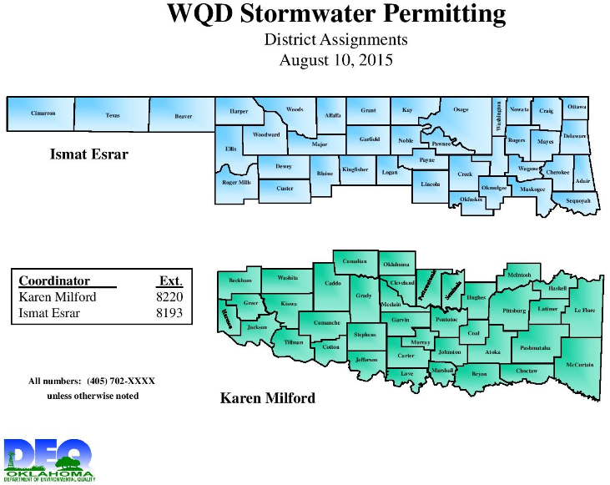
ODEQ’s Stormwater Permit Territory

Slide 4
ODEQ Stormwater Staff
For Stormwater permitting questions and TMDL implementation questions relating to stormwater permits and programs:
North District – Ismat Esrar
South District – Karen Milford
For Enforcement and Audit and program assessment questions:
Wayne Craney (Manager)
Michelle Chao
Unfilled positions at present.

Slide 5
OKR04 Applications Processed
Filing Deadline: January 29, 2016.
Some extensions granted; a few took months to file.
Notice of Intent (NOI) plus the following attachments:
Summary Status Report (existing permittees only),
SWMP Description (BMPs, Meas. Goals, schedules),
MS4 boundary map,
Another governmental entity,
List and map of ARC, ORW, 303(d), and established TMDLs,
7th MCM SWP3 Template (if applicable).

Slide 6
7th MCM SWP3 Template
Only needed if applicant selected the 7th MCM.
Applies to both existing and new permittees.
INCOG’s original SWP3 Template was based upon an ODEQ checklist for SWP3 contents.
ODEQ wanted direct addressment of all SWP3 requirements as stated in OKR04.
Applicants received lists of deficiencies and required individual responses by each permittee.
To date, apparently all deficiencies are resolved.

Slide 7
Letters of Discharge Authorization
50 OKR04 applications were processed by ODEQ.
12 of 50 (24%) applicants elected to use the 7th MCM.
By late-January, 29 Letters of Authorization had been or were scheduled to be issued.
By March, nearly all of the 50 applicants are now authorized under the new (2015) OKR04 permit or have completed their 30-day public comment period.
ODOT, a Phase II permittee, elected to work under an Individual Permit instead of OKR04.

Slide 8
Annual Report Due Date Issues
Existing Permittee Due Dates and Periods of Record (PORs):
PROGRAM RECORDING YEAR | PERIOD OF RECORD START DATE | PERIOD OF RECORD END DATE | ANNUAL REPORT DUE DATE | MONTHS REFLECTED IN AR
Calendar | Jan 1, 2016 | Dec 31, 2016 | Mar 1, 2017 | 12
Fiscal | Jan 1, 2016 | Jun 30, 2017 | Sep 1, 2017 | 18
New Permittees With Either Calendar Year or Fiscal Year Programs:
ODEQ will notify you at the time of receipt of the Authorization to Discharge when your first Annual Report is due.

Slide 9
INCOG’s Annual Report Template
INCOG followed OKR04 AR requirements.
Questions remained about levels of detail ODEQ might want on many AR items.
ODEQ’s email to permittees that they can use templates from INCOG, EPA or other sources, but ODEQ may request additional information after AR submittal.
INCOG will use the ODEQ requests to modify the AR Template for future use.

Slide 10
ODEQ Program Assessments (Audits)
ODEQ plans to perform a formal program assessment (audit) of each municipal stormwater permittee at least once during this present 5-year permit cycle.
Each audit will be 2-3 days duration and cover all aspects of the permit program.
Permittees will be notified several weeks in advance, and documents will be requested in advance for ODEQ review.
Permittees will have the audit checklist in advance to fill out before the audit.
Audits will begin this year (2017).

Slide 11
SWMP Deficiencies
In Fall 2016, Ismat expressed concern that most of the NOI application BMP lists had the same info stated in INCOG’s SWMP Template.
Rather than have applicants re-submit corrected BMP tables, Ismat said that MS4s will need to revise their SWMPs over the coming year.
INCOG suspects that other parts of the SWMP documents (e.g., the procedures) were not customized either. ODEQ will see this as audits proceed.
This will likely be a major challenge for permittees.

Slide 12
TMDLs in OKR04
The only TMDL finalized so far that affects MS4s is for Lake Thunderbird (2013).
A similar draft TMDL for the North Canadian River Area (2015) received very detailed and difficult to address comments; the TMDL is still draft.
The L. Thunderbird TMDL Monitoring Plan is beyond the capabilities of most Phase II permittees.
ODEQ is trying to resolve the many TMDL issues raised by these 2 TMDLs so that future TMDLs with MS4s can be implemented reasonably.

Slide 13
Status of 2016 303(d) List
ODEQ recently submitted the draft 2016 303(d) List to EPA for review and approval.
There may be some back-and-forth negotiations between EPA and ODEQ.
After EPA approval, ODEQ will hold a 30 day Public Comment period, then the 2016 list will be final.
Until then, continue to use the 2014 list.
TMDL and 303(d) issues will be covered in detail at the June 12, 2017 GCSA Employee Training Workshop.

Slide 14
Making Changes to SWMP & BMPs
Two types of changes: to SWMP text and to BMPs.
OKR04 Part IV.D.1: “must conduct an annual review of your SWMP in conjunction with preparation of the Annual Report”.
OKR04 Part IV.D.2: “your SWMP must be modified as needed… in accordance with the following procedures:”
Adding (but not deleting or replacing) “components, controls or requirements to the SWMP” … at any time upon written notification to ODEQ;
Replacing a BMP… requested at any time… with analysis of the need for change.

Slide 15
City of Tulsa’s Household Pollutant Collection Facility Special Events Presented by Jacob Hagen City of Tulsa

Slide 16
Questions ??
Vernon Seaman
Manager, Envir. And Energy Planning
INCOG
Two West 2nd Street, Ste 800
Tulsa, OK 74103
(918) 579-9451
vseaman@incog.org

